Slide 1


Automatic Fraud Detection
Data Pipelines for AI

Slide 2
Context
Tasks
Problem: Fraudulent credit card transactions
Train machine learning models on historical transactions dataset
Need real-time fraudulent transactions identification
Design an infrastructure to integrate the models with real-time data
Development of a scalable production-ready infrastructure
Deploy the infrastructure components
Provide analytics and notifications when fraud occurs
Machine learning models
ETL pipeline
Data storage
Data consumer

Slide 3
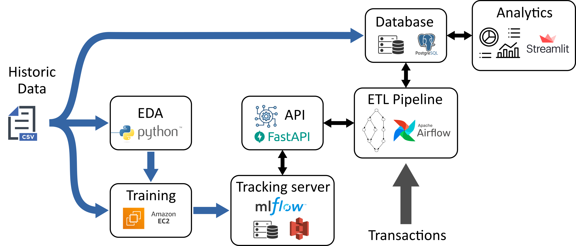

Pipeline architecture
Servers deployment on

Slide 4
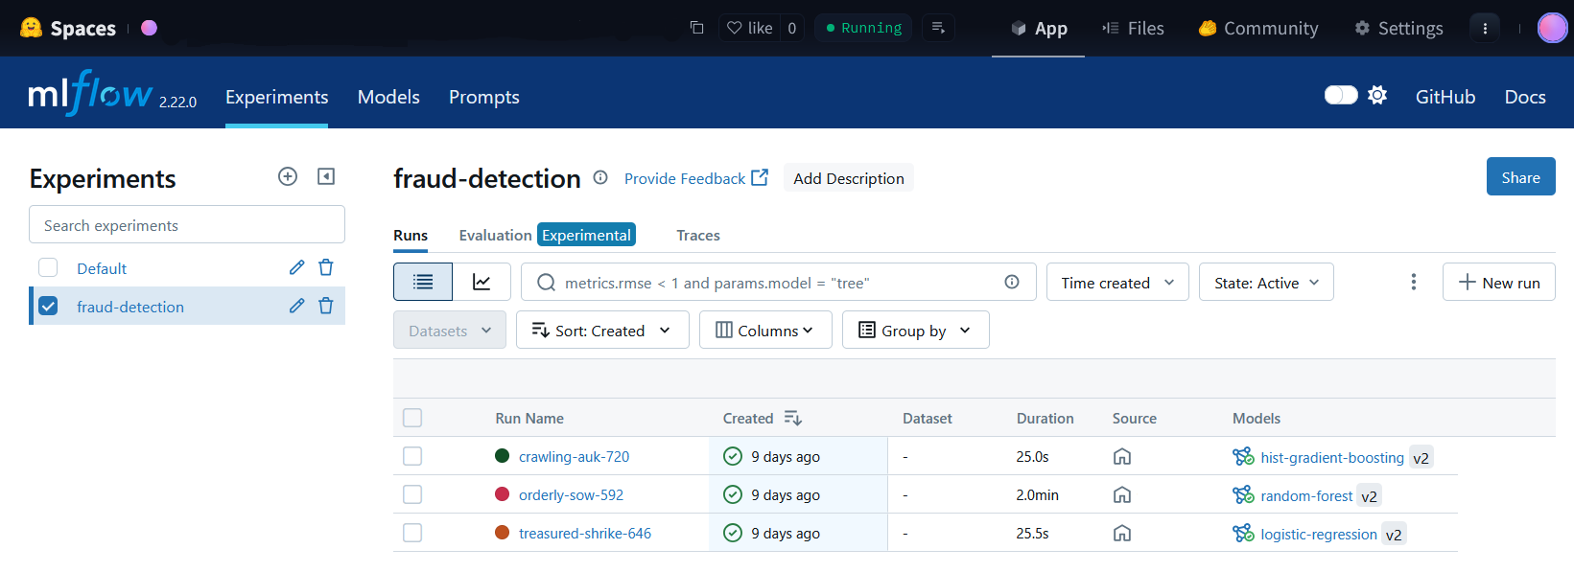
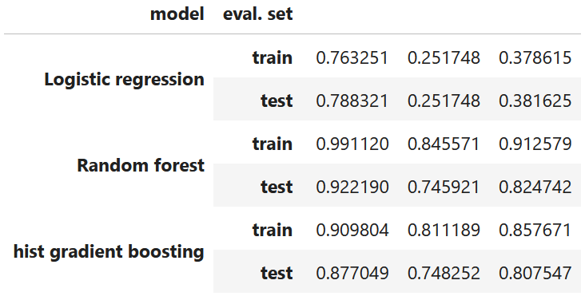
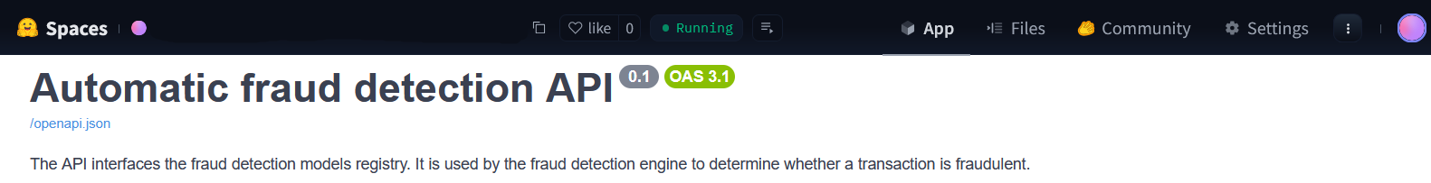
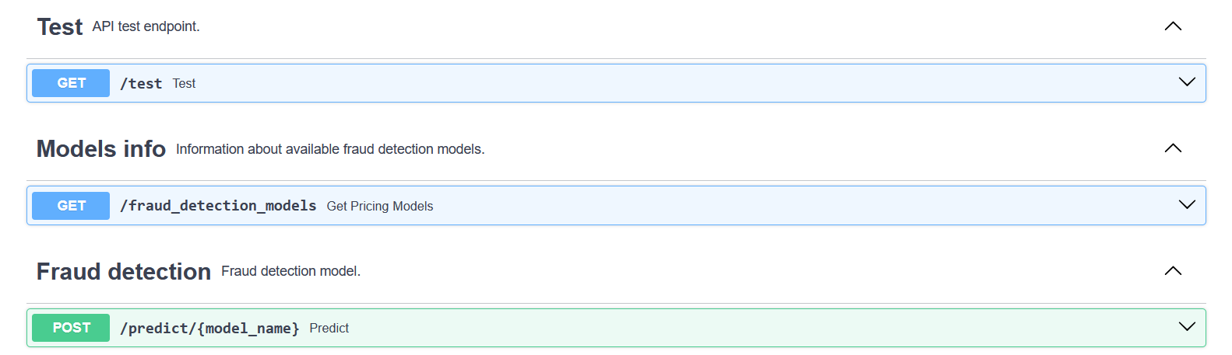
Fraud detection service
Model design (scikit-learn)
Training and tracking (MLflow)
Fraud detection API (FastAPI)

Slide 5
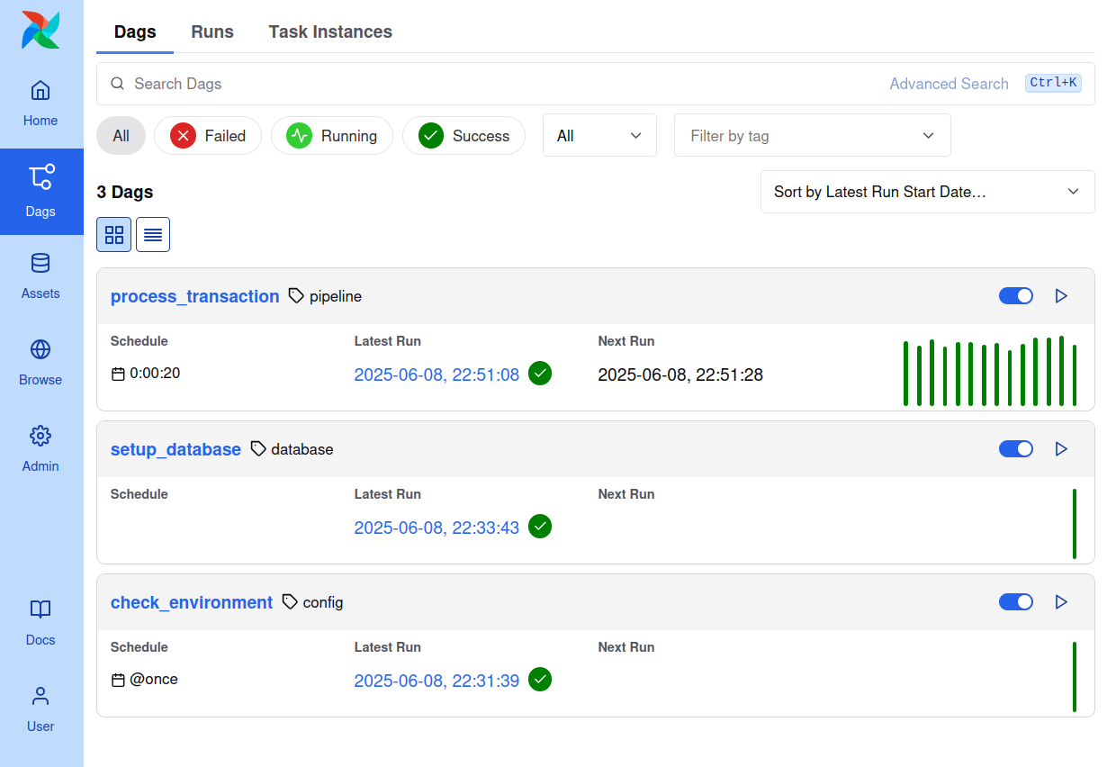
ETL pipeline
Workflow orchestration with Airflow
Task DAGs
check_environment (admin.)
setup_database (admin.)
process_transaction (ETL)

Slide 6
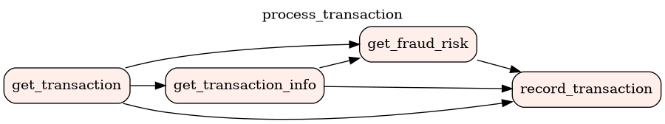
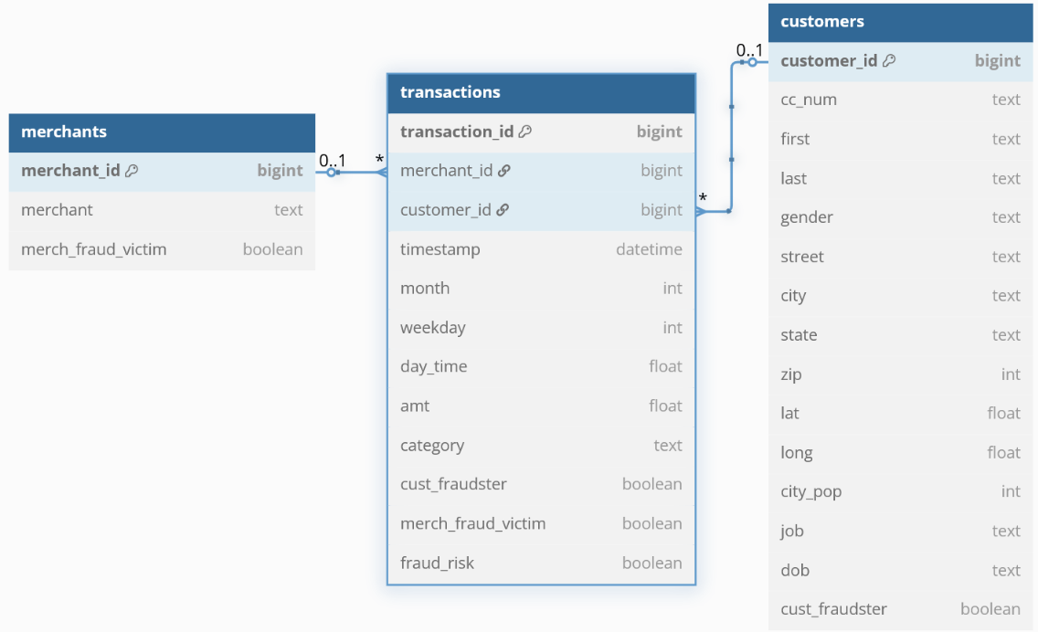
ETL pipeline
ETL : process_transaction
Storage in SQL database
Fetch real-time transaction
Get additional information from database (e.g., transaction id)
Request fraud detection API
Record transaction in database
customers (reference)
merchants (reference)
transactions (transactional)

Slide 7
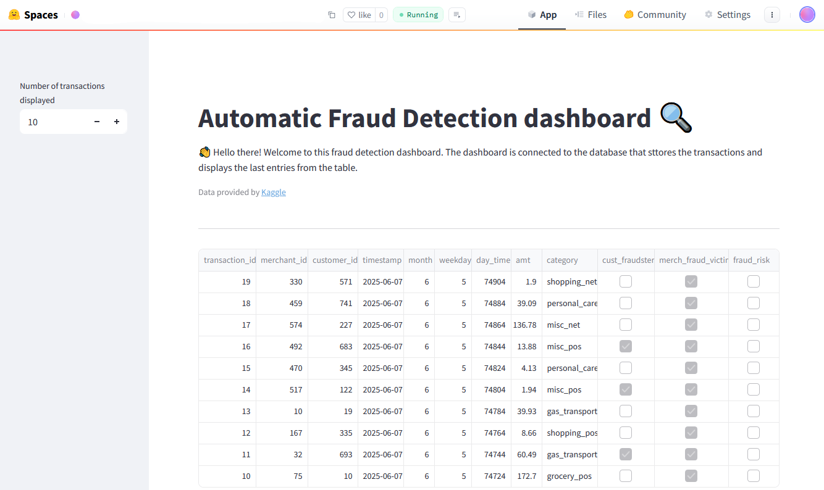
Dashboard
Check database availability at startup
Fetch last transactions from database
Display transactions in a table

Slide 8

Thanks!

